Slide 1
PRESENTASI BULAN APRIL
SALSABILA AZZAHRA

Slide 2
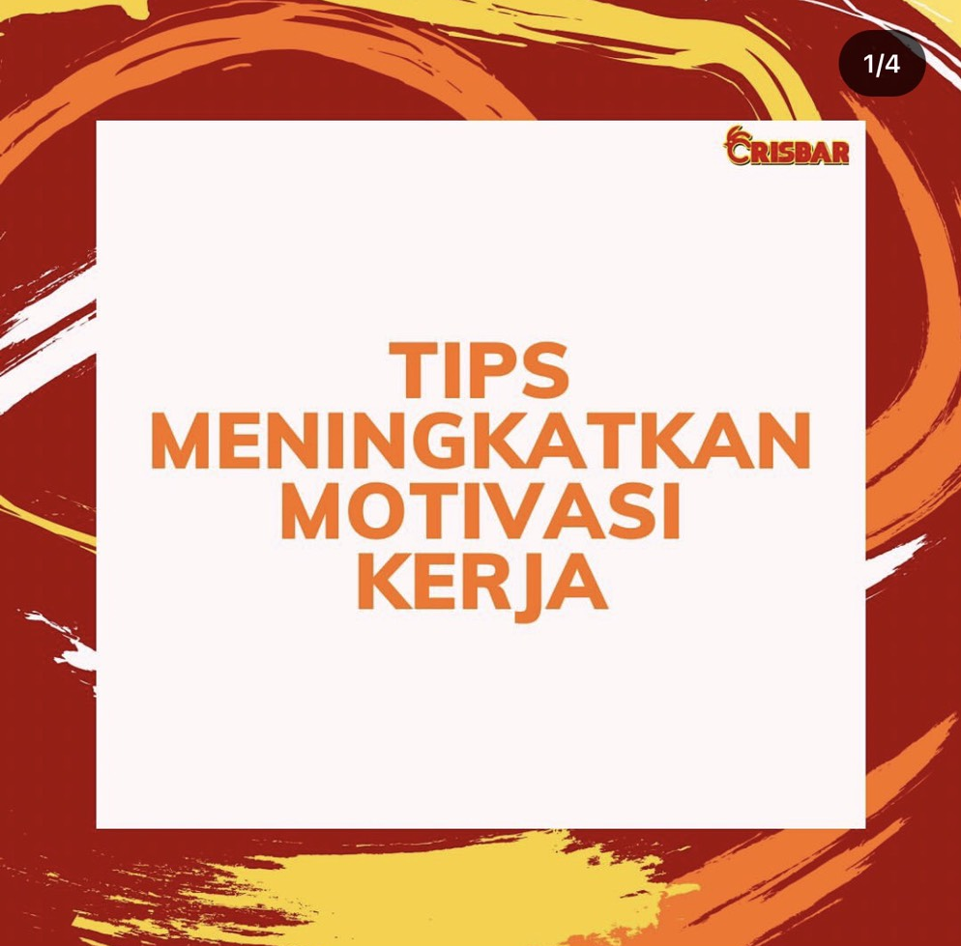
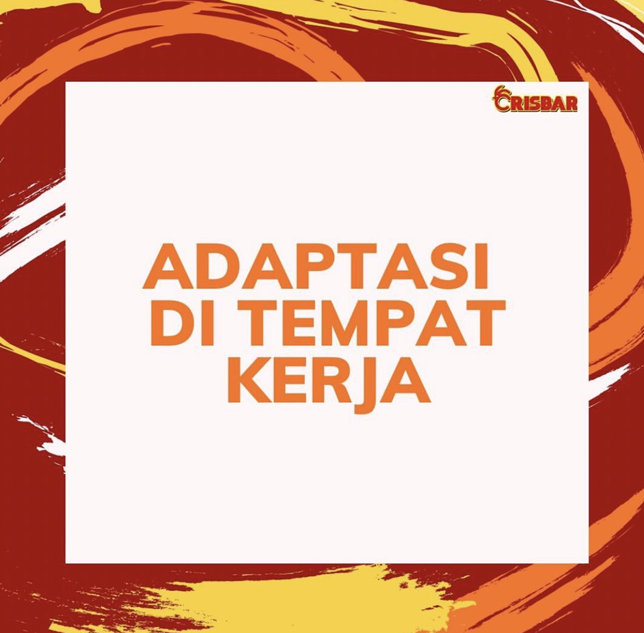
POST FEED IG

Slide 3
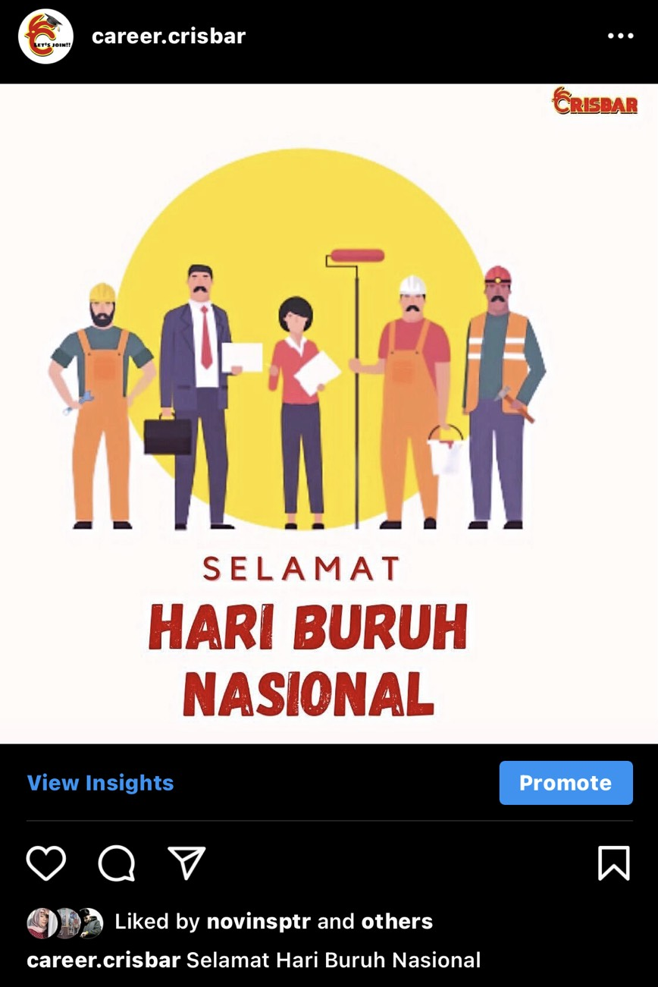

POST FEED IG

Slide 4
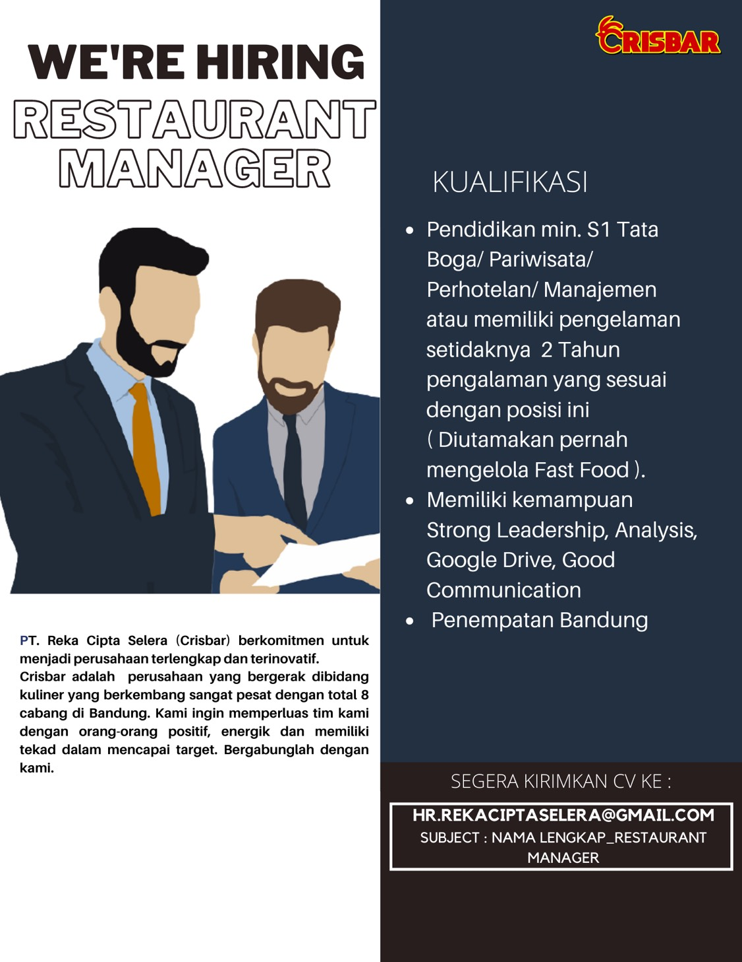
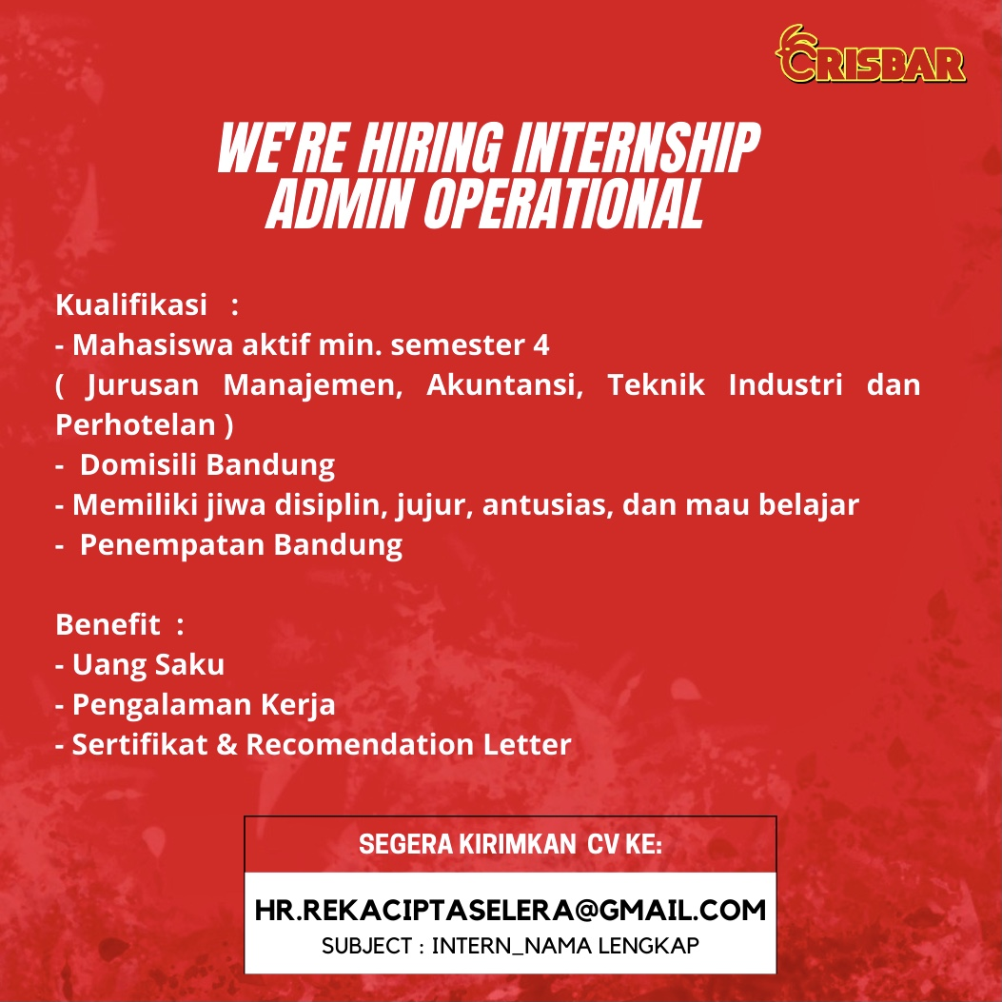
flyer

Slide 5
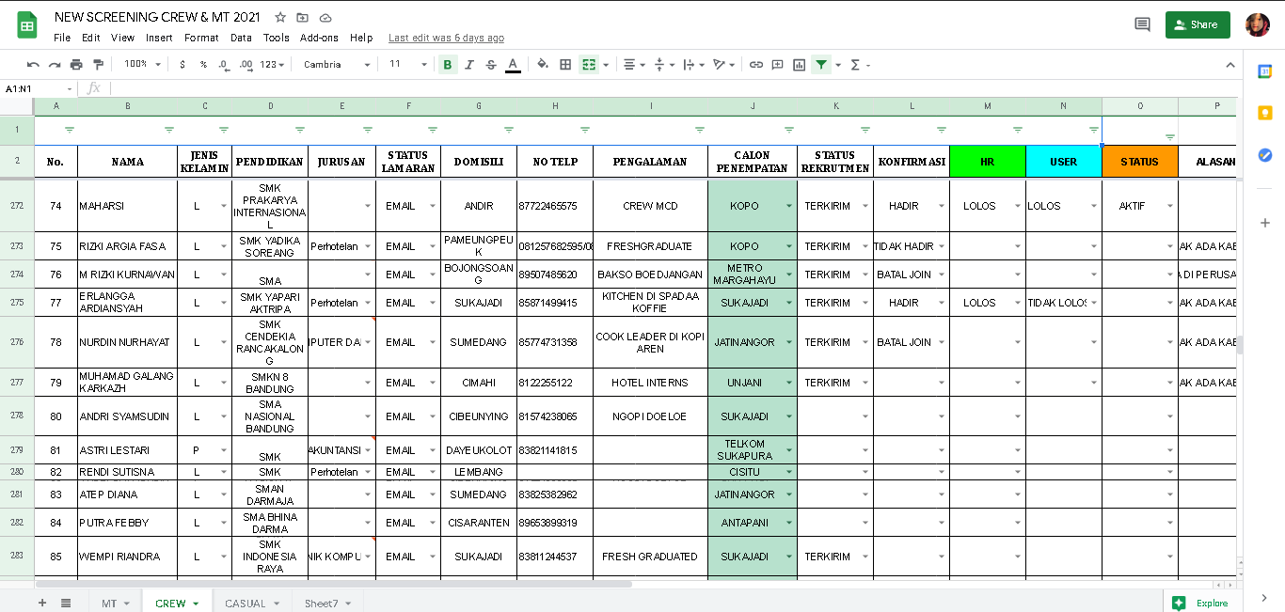
Screening CV bulan April
Screening : 134 orang
Proses : 45 orang
Terkirim : 23
Tidak terkirim: 4
Konfirmasi hadir : 19
Lolos : 17
Batal join : 26
Batal join pada saat dihubungi, rata-rata tidak ada kabar dan sudah diterima di perusahaan lain
A killer cheesy combo with a kick
Presentations are communication tools that can be used as demonstrations, lectures, speeches, reports, and more. It is mostly presented before an audience.
To create a stunning presentation, it's best to simplify your thoughts. Start with an outline of topics.

Slide 6
Yang dilakukan di bulan april
Membantu melakukan Psikotes & Interview
Membantu melakukan assessment karyawan
Membuat pin karyawan baru
Print voucher makan bulan Mei
Membantu input absen
Update data karyawan
Membantu rekap nilai kerja kualitatf
Data seragam karyawan
Membuat konten employee branding
Arsip berkas

Slide 7
Saran
Form rekrutmen karyawan

Slide 8

THANK YOU

